Slide 1
STAT 5340 Statistical Analysis I
Graphical & Numerical Summaries
Of Data

Slide 2
Plot/Graph Your Data!
The Human Eye-Brain Combination is perhaps the best
Pattern Recognition Processor in the known Universe
Consider the example of
Hours Worked by Java
Developers by Location
Region | Hours Worked
U.S. | 48
Northeast | 47
Mid-Atlantic | 49
South | 47
Midwest | 47
Central Mt | 51
California | 50
Pacific NW | 47
Canada | 43
Europe | 48
Asia | 47
South America and Africa | 49
The low value for Canada is not as
Obvious in the Table as it is in the Plot
Plots & Graphs are generally of more value as data sets get larger

Slide 3
Graphs for Qualitative Data
Graphs/Plots for Qualitative Data are generally more limited
Recall Qualitative Data carries Less Information than Quantitative Data

Slide 4
Graphs for Quantitative Data
Smaller Data Sets (say N < 40)
Stem & Leaf Diagrams – Display All
the Data Both Graphically and
Numerically
Dot Plots – Display All the Data
Stem-and-Leaf Display: Hours
Stem-and-leaf of Hours
N = 12
Leaf Unit = 0.10
1 43 0
1 44
1 45
1 46
6 47 00000
6 48 00
4 49 00
2 50 0
1 51 0

Slide 5
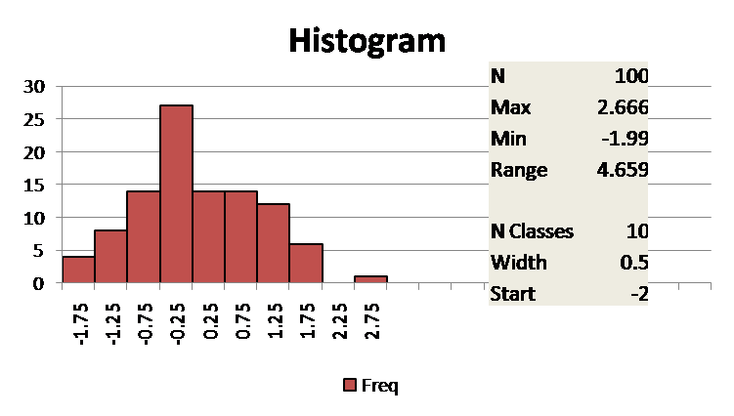
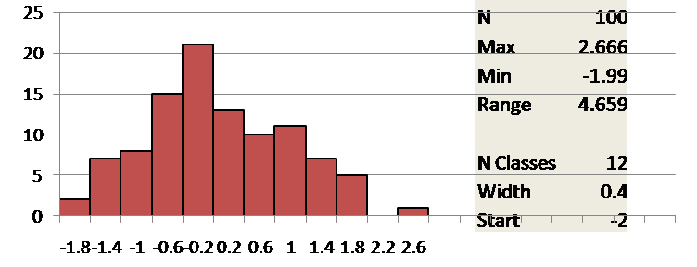
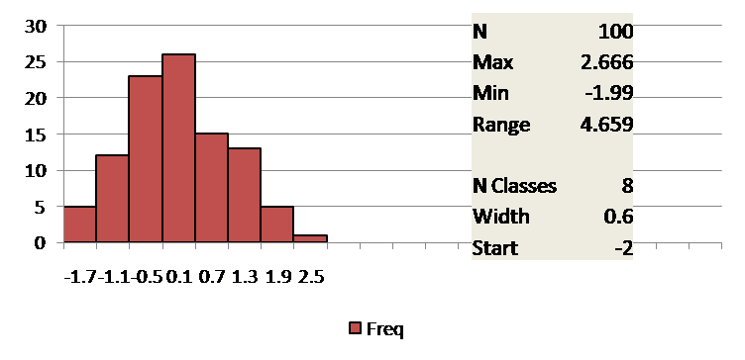
Graphs for Quantitative Data
For Small Data Sets (say N<40)
- Dot Plots – display all data values
- Stem-and-Leaf Displays – display all data
values graphically and numerically
- Special Cases of Histograms
For Larger Data Sets
- Histograms
- Cumulative Frequency Plots (Ogives)
Constructing Histograms
Find N, Max, Min, Range
Choose
Number of Classes (m)
m~ Sqrt(N)
Usually <=20
Class Width (c)
m*c > Range
“Even” width if possible
Start Point (< Min)
Guidelines
Classes all same width
No Overlap
Data Values Belong to Only 1 Class

Slide 6
Histograms Suggest Population Distributions

Slide 7
Histograms & Ogives
An Ogive is more commonly
Called a Cumulative Frequency or
Cumulative Relative Frequency Plot

Slide 8
Cumulative Relative Frequency Plots
Normal – S-shaped
Uniform – Straight Line
Skewed – Curved
Multiple Distributions can be plotted
on a single chart for Comparison

Slide 9
Measures of Central Tendency
Mean = Average
- Add all the values = 573
- Divide by the number of values = 12
- Average = 573/12 = 47.75
Median = Middle Value
- Order the data lowest to highest
43,47,47,47,47,47,48,48,49,49,50,51
- Odd number of data points – choose middle value
- Even number of data points – average middle two
12 data points so average 6th & 7th value
(47+48)/2 = 47.5
Mode = Most Frequently Occurring Value
- Self-explanatory, there are 5 47’s, so 47
Mid-Range = Midpoint of the Extremes
- Average of smallest and largest data values
(43 + 51)/2 = 47
Mean ( X-bar) is most commonly used, Median is next most common

Slide 10
Measures of Dispersion
Range = Largest – Smallest Data Value
- Range = 51 -43 = 8
Mean Absolute Deviation from the Mean
- Subtract the Mean from each data value, and
- Take Absolute Value of result (make positive)
.25,.25,.75,.75,.75,.75,.75,1.25,1.25,2.25,3.25,4.75
- Find Mean of resultant data values (1.4167)
Median Absolute Deviation from the Median (MAD)
- Subtract the Median from each data value, and
- Take Absolute Value of result (make positive)
.5,.5,.5,.5,.5,.5,.5,1.5,1.5,2.5,3.5,4.5
- Find Median of result (0.5)
- Divide by 0.6745, scalar to ~1 standard deviation (0.7143)
Variance
- Sum Squared Deviations from the Mean = 44.25
- Divide by Number of data values – 1 = 12 -1 = 11
- Variance = 44.25/11 = 4.022727
Standard Deviation = Square Root of the Variance
- Sqrt(Variance) = Sqrt(4.022727) = 2.005674
NOTE: Can also be
expressed as:
{Sum of Squares –
n(Mean)²}/(n-1)
Standard Deviation (S) is Most Commonly Used, Range also Common
Statisticians Like Variances (S²) because they are additive, S is not

Slide 11
Measures of Position
Quartiles-
- 1st Quartile (Q1)
- Value with 25% of the
Data below it & 75% above
- 2nd Quartile (Q2) = Median
- Half data below & half above
- 3rd Quartile (Q3)
- Value with 75% of the
Data below it & 25% above
- Inter-Quartile Range (IQR)
- Q3-Q1
- Includes middle 50% of Data
- Can be divided by 1.35 to
approximate 1 standard deviation
…
…
Percentiles-
- Analogous to Quartiles
- k^{th} Percentile (P_{k})
- Value with k% of the
Data below it & (1-k)% above
Z-Scores-
- Number of Standard
Deviations from Mean
- (Value – X-bar)/S

Slide 12
Measures of Position 5-Value Summary – Box Plots
Box (& Whisker) Plots formed using
5 values from the sample data
- Box – top = Q3, bottom = Q1
- Cross-bar in Box = Median
- Whiskers – top = Max, bottom = Min
Box Plots do not suffer
From same subjectivity
As Histograms, Can be
Plotted with fewer Data
Values, and Many Can be
Plotted on the same Chart

Slide 13
Using Measures of Position to Identify Outliers
Outliers = Fliers tend to show up in most data sets
- Do not want them to overly influence the summary and conclusions for the
majority of the results
- May carry important information, so source for unusual results should be
investigated
Often, flier limits are established using multiples of the Inter-Quartile Range (IQR)
One common set of flier limits is given by:
- UFL = Q3 + 2*IQR
- LFL = Q1 – 2*IQR
Should erroneously throw out a valid result only about 7 in 10,000 data results (~0.07%)
If outside these limits, then value is likely to be different than the majority of the data

Slide 14
Bivariate Data
Bivariate Data is comprised of two results where there is some common bond or link between the results, eg:
HDL and LDL cholesterol from the same individual
Revenue and Earnings per Share for the same company
Tumor size before and after a specific treatment protocol for a specific patient
Throughput and Yield for a specific manufacturing line
Soil acidity and moisture levels for a specific plot of land
Strikeouts and Earned Run Average for a specific pitcher
Many others
Generally interested in the relationship between the two variables comprising a bivariate data set.

Slide 15
Summaries by Types of Variables Two Qualitative Variables
Cross-Tabulation Tables
By Count
Bivariate Bar Chart
By Percentage

Slide 16
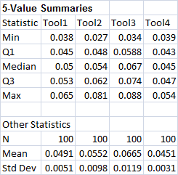
Summaries by Types of Variables One Qualitative & One Quantitative Variable
Side-by-Side Box Plots
Example
o 4 Different Tools
Producing Same
Product
(Qualitative)
o Measurements
of Critical Dimension
on Product
(Quantitative)

Slide 17
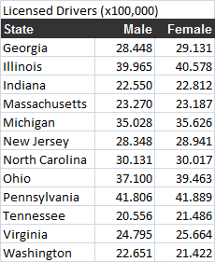
Summaries by Types of Variables Two Quantitative Variables
Scatter Diagrams

Slide 18
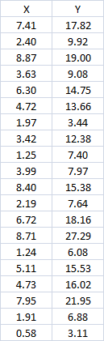
Plot the Data
Scatter plots provide a picture of the data
“A picture is worth a thousand words.” - Confucius
Here we see the variables are generally linearly related
with Y increasing as X increases
There are also some statistics that can be generated to assess the
nature of the relationship between two variables:
- Sample Covariance
- Sample Correlation Coefficient

Slide 19
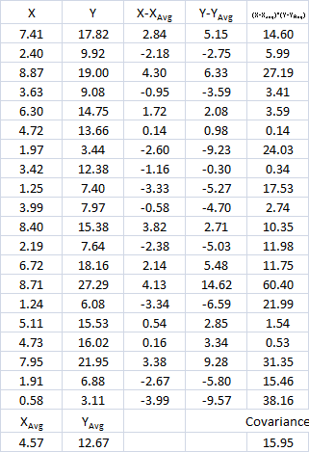
Sample Covariance
Sample Covariance is given as
s_{xy} = Sum{(x_{i}-x_{Avg})*(y_{i}-y_{Avg})}/(n-1),
where
(x_{i}, y_{i}), i = 1, …, n form a bivariate data set with
x_{Avg} = Sum(x_{i})/n & y_{Avg} = Sum(y_{i})/n, and all Summations from i = 1 to n.
s_{xy} > 0
Positively Related
As x increases, y increases
s_{xy} < 0
Negatively Related
As x increases, y decreases
Range for s_{xy}
-∞ to +∞
So what can the sample covariance tell us about the
relationship between X and Y?
What does the sample covariance fail to tell us about
the relationship between X and Y?

Slide 20
Linear Correlation Coefficient
If we normalize the Sample Covariance through division by the respective
sample standard deviations of the variables X and Y, we obtain the
Linear Correlation Coefficient, given as
r_{xy} = s_{xy}/(s_{x} * s_{y}),
where s_{x}² = Sum{(x_{i}-x_{Avg})²}/(n-1), s_{y}² = Sum{(y_{i}-y_{Avg})²}/(n-1),
with (x_{i}, y_{i}), i = 1, …, n form a bivariate data set,
x_{Avg} = Sum(x_{i})/n & y_{Avg} = Sum(y_{i})/n, and all Summations from i = 1 to n.
Range for r_{xy}: -1 to 1
Same interpretation of sign as
for Covariance
Advantage for Linear Correlation
Coefficient over Covariance:
Can also measure relative “strength”
of linear relationship

Slide 21
Linear Correlation Measures LINEARITY of Relationship
Positive Linearity
Negative Linearity
No Linearity
Plot Your Data!
Do Not Rely on
r Values Alone
To Assess the
Relationship

Slide 22
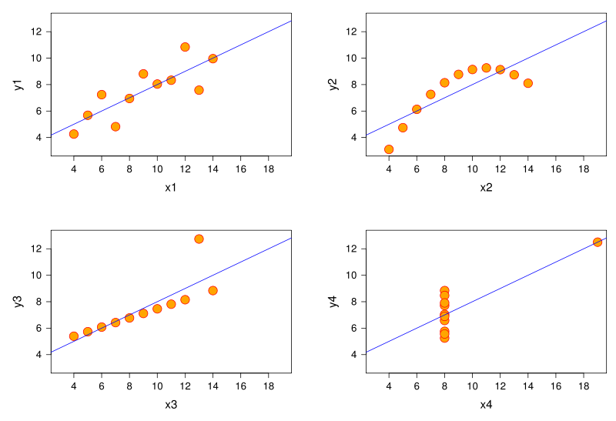
Linear Correlation
All correlation coefficients = 0.81

Slide 23
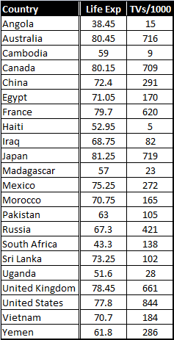
Linear Correlation Does Not Necessarily Imply CAUSATION
r = 0.74
Positive Correlation between Life Expectancy, TVs/1000
Would sending more TVs to Countries Increase Life Expectancy?
Both Driven More by Wealth or Income per Capita
Strong Correlation Does NOT Imply Causation; however,
Causation Generally Results in Some Degree of Correlation

Slide 24
Sequence Plots
Univariate data that is collected in sequence (usually, time) is essentially bivariate data with the sequence as the second variable.
All these time series show different behavior, and while plots are always of value, there is an entire course dedicated to time series modeling.

